Slide 1
3D Printing: Why it Matters and How it Can be Improved
Will Langford
Tufts University
EM 52: Technical Writing
Spring 2012
Notes:
Have fun! Breathe!
Hi everyone. My name is Will and I’m a senior mechanical engineer.
Today I’d like to tell you something I’m truly passionate about: 3D printing.
Specifically, I’d like to talk about the future of the technology and a few of the technical challenges that are left to be tackled to improve the quality of 3D printed objects.

Slide 2
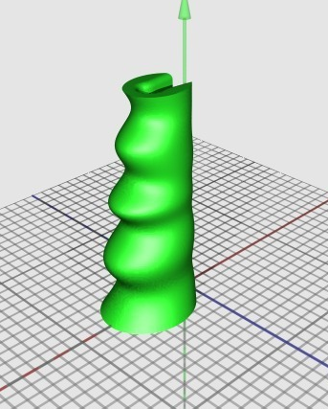
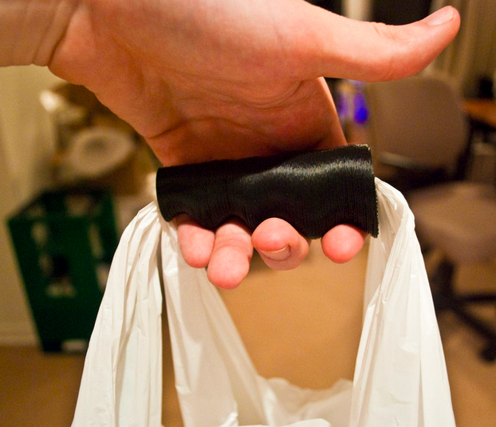
What is 3D Printing?
Fused deposition modeling (FDM)
Notes:
First I’d like to ask you all a question: Show of hands… Who’s heard of 3D printing or knows what it is?
Okay. That’s great. Well for those of you who don’t know…
3D printing is a way of creating physical objects from virtual 3D designs.
It’s an additive process which means that objects are built layer by layer.
There are many different types of 3D printing and today I’ll focus on one called fused deposition modeling.
Fused deposition modeling gets its name from the layers of thermoplastic that are fused together and built up to form an object.

Slide 3
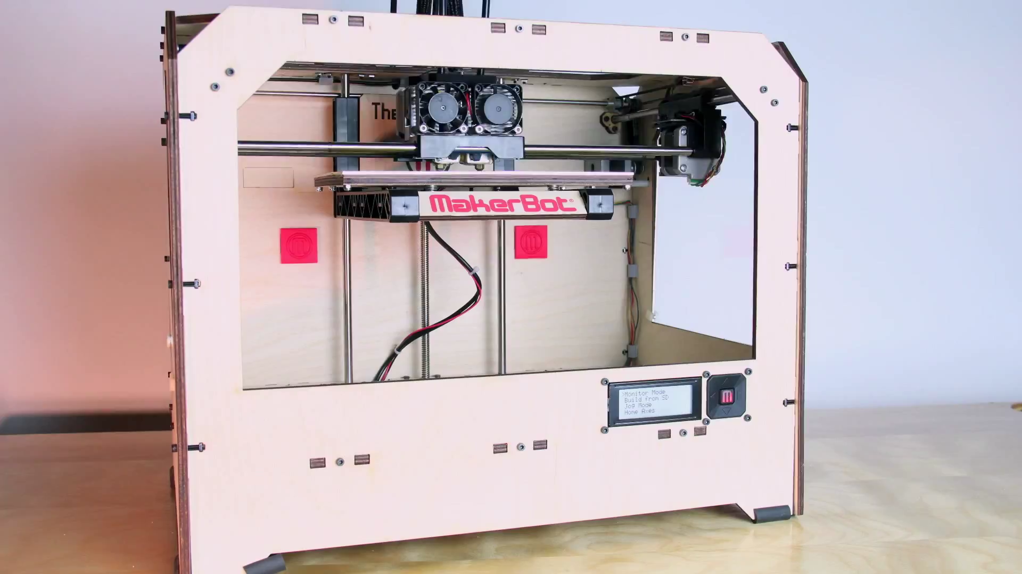
[1]
[1] http://www.youtube.com/watch?feature=player_detailpage&v=euZivv8ySyA#t=117s
Notes:
The process looks something like this…

Slide 4
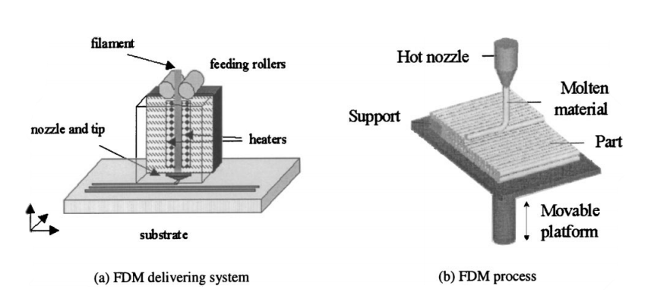
Parts of a 3D Printer
Cartesian Gantry System (moveable platform)
Moves the extruder in x, y, and z directions
Thermoplastic Extruder
Deposits material on the build platform
Source: Stratasys
Notes:
There are two main parts of a 3D printer:
The first is the cartesian gantry system. You can think of this as just a movable platform. The gantry is responsible for precisely positioning the extruder [show extruder] over the build platform [show build platform].
Then there’s the thermoplastic extruder. The extruder is what deposits material, thermoplastic in this case.
The extruder takes a plastic filament input [like this] and forces it through a heated nozzle where it melts the plastic and pushes it out as super fine angle hair spaghetti.
The extruder is then moved over the build platform and deposits material to draw a picture. Once the layer is complete, it moves up one layer height and draws the next layer.
This process is repeated until the full object is complete. [Show example object]

Slide 5
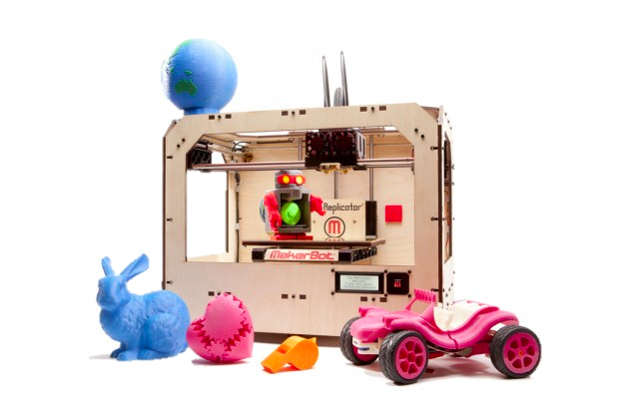
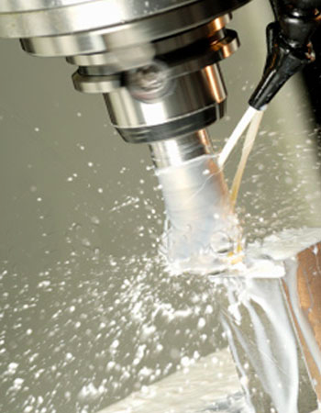
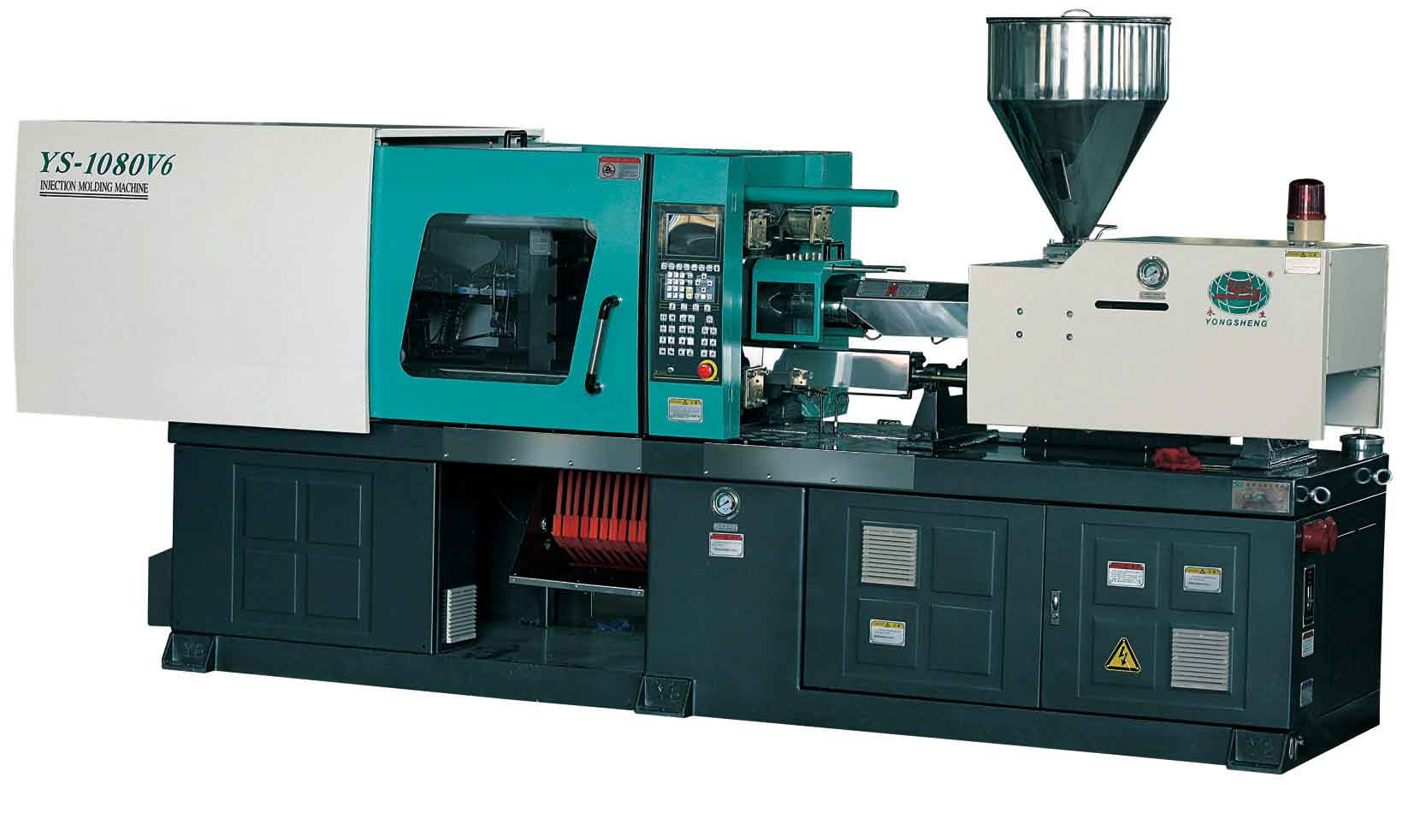
There is a Problem With Manufacturing…
Machining
3D Printing
Injection Molding
A gap
[1]
[1]
[2]
[3]
< 50 units
~ $300 per unit
< 1,000 units
~ $5-50 per unit
> 1,000 units
~ $2k up-front + $5 per unit
[1] http://www.stdtechnology.com/
[2] http://machine-ys.en.made-in-china.com/product/YqTncUtVOihy/China-PC-Transparent-Shoe-Sole-Injection-Molding-Machine.html
[3] http://betakit.com/2012/02/26/economic-implications-of-3d-printers
Notes:
But wait… Why should you care about 3D printing?
Well… there’s a problem with manufacturing today.
Let’s say you have a design that you want to have manufactured…. Maybe it’s the perfect case for your iPhone.
You have to choose one of two routes to get it made:
You can have the design machined but it’ll be really expensive per unit and only makes sense if you want a very small number of units.
Or… You can have the design injection molded. It costs thousands of dollars up-front but you can have each subsequent unit for only a couple of dollars.
But neither of these work for you… There’s this big gap in the middle for cheap low-run production.
And here’s where 3D printing comes in… 3D printing is a cheap way to do production in relatively small quantities.

Slide 6
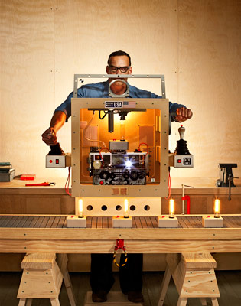
Distributed, Personal Manufacturing
Corporate → Personal
[1]
[1] http://www.wired.com/magazine/2010/01/ff_newrevolution/all/1
Notes:
What’s more… 3D printing is all automated so its relatively easy to use.
It gives people like me and you, people who may not necessarily have the means to make things, the power to make and produce our own products.
I can make a plastic object in my dorm room that would ordinarily require a whole machine shop with thousands of dollars of tools.
There’s this shift from manufacturing as a purely corporate activity to one that we can engage with on a personal level.
and this is what really excites me about 3d printing... It’s how 3D printing can empower individuals to make things and share those things with others.

Slide 7
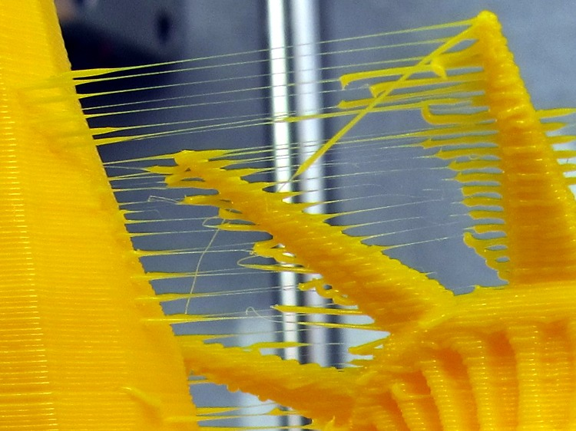
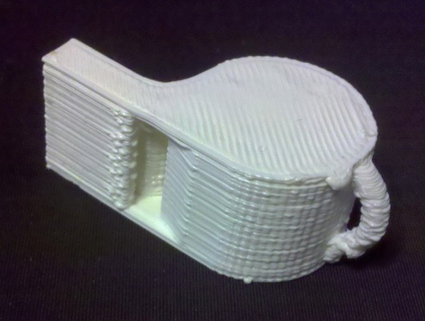
Imperfections of 3D Printing
Source: http://softsolder.com/2011/09/26/reversal-zits-early-action-variations/
Source: http://blog.cnccookbook.com/2012/02/11/high-resolution-3d-printer/
Notes:
Visible layers
Ridges, bumps, and gaps

Slide 8
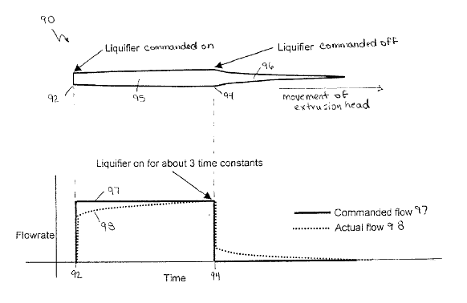
Causes of Imperfections
Imprecise flow control
There is a mismatch between desired and actual flow
Source: Stratasys

Slide 9
Improving Precise Flow Control
Characterizing the flow experimentally
Theoretical causes of imprecise flow
Practical methods of improving precision

Slide 10
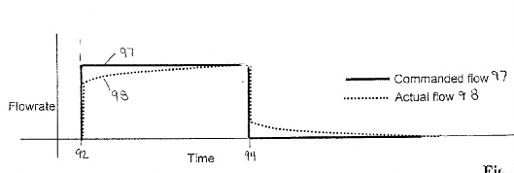
Characterizing an Extruder’s Flow: Dynamic Modeling
Characterizing the flow
Theoretical Causes
Practical Improvements
Dynamic Model
Input
Output
e.g. desired flow-rate
e.g. actual flow-rate
Source: Stratasys

Slide 11
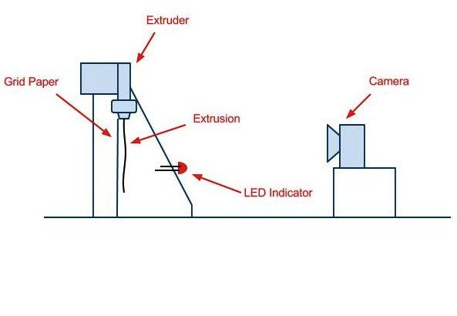
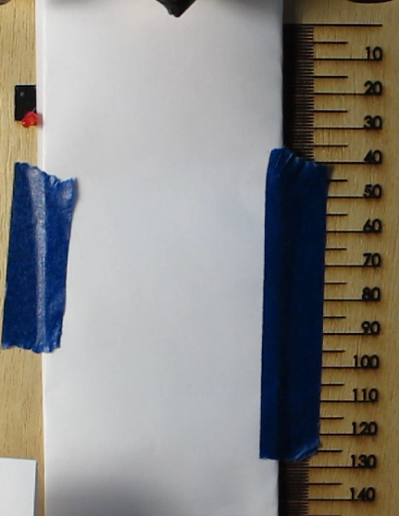
Characterizing an Extruder’s Flow: The Experiment
Characterizing the flow
Theoretical Causes
Practical Improvements
Turned the extruder on for five seconds:
@ 2 RPM, 3 RPM, and 5 RPM
Used a camera to find the length of the extrusion at every time-frame

Slide 12
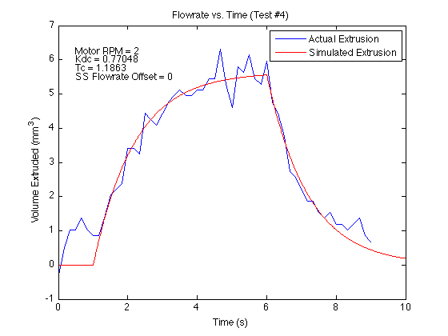
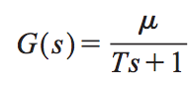
Characterizing an Extruder’s Flow: Fitting the Model
Characterizing the flow
Theoretical Causes
Practical Improvements
steady-state gain
[1]
time constant
extruder turned on
extruder turned off
[1] Source: Bellini et al.
Notes:
Now that we’re able to characterize the flow of an extruder, let’s look at some theoretical causes of imprecise flow.

Slide 13
Theoretical Causes of Imprecise Flow: Melt-Zone Effects
Characterizing the flow
Theoretical Causes
Practical Improvements
Under-deposition
Over-deposition
Notes:
One of the major effects that make the flowrate hard to predict is the movement of the melt-zone.
The melt-zone is the area in the hot-end in which the filament becomes molten just before it reaches the nozzle.
The size of the melt-zone is governed, in large part, by the speed at which the filament is pushed through the hot-end. A filament that is pushed into the hot-end quickly will have less time to become molten than one inserted slowly, thereby creating a smaller melt-zone.
Intuitively, a larger melt-zone implies a higher average temperature in the hot-end. This higher temperature means the melt flow is more runny (or less viscous).
What happens, then, when an extruder is suddenly commanded to increase its flowrate is that the melt-zone shrinks and the extruder under-deposits material (since the melt is becoming more viscous). Similarly, when an extruder is told to suddenly stop extruding, the melt-zone increases in size and the extruder over-deposits material (since the melt is becoming less viscous).

Slide 14
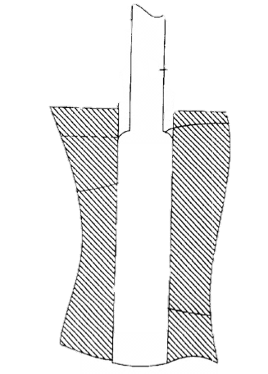
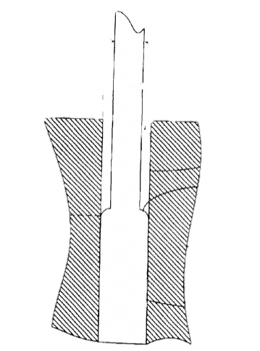
Theoretical Causes of Imprecise Flow: Melt-Zone Effects
Characterizing the flow
Theoretical Causes
Practical Improvements
Melt-zone = area where filament becomes molten
filament
high-speed
melt-zone
low-speed
small melt-zone
large melt-zone
high avg. temp.
low avg. temp.
high viscosity
hot-end
low viscosity
low-speed
high-speed
under-deposition
over-deposition
Source: Stratasys
Notes:
One of the major effects that make the flowrate hard to predict is the movement of the melt-zone.
The melt-zone is the area in the hot-end in which the filament becomes molten just before it reaches the nozzle.
The size of the melt-zone is governed, in large part, by the speed at which the filament is pushed through the hot-end. A filament that is pushed into the hot-end quickly will have less time to become molten than one inserted slowly, thereby creating a smaller melt-zone.
Intuitively, a larger melt-zone implies a higher average temperature in the hot-end. This higher temperature means the melt flow is more runny (or less viscous).
What happens, then, when an extruder is suddenly commanded to increase its flowrate is that the melt-zone shrinks and the extruder under-deposits material (since the melt is becoming more viscous). Similarly, when an extruder is told to suddenly stop extruding, the melt-zone increases in size and the extruder over-deposits material (since the melt is becoming less viscous).

Slide 15
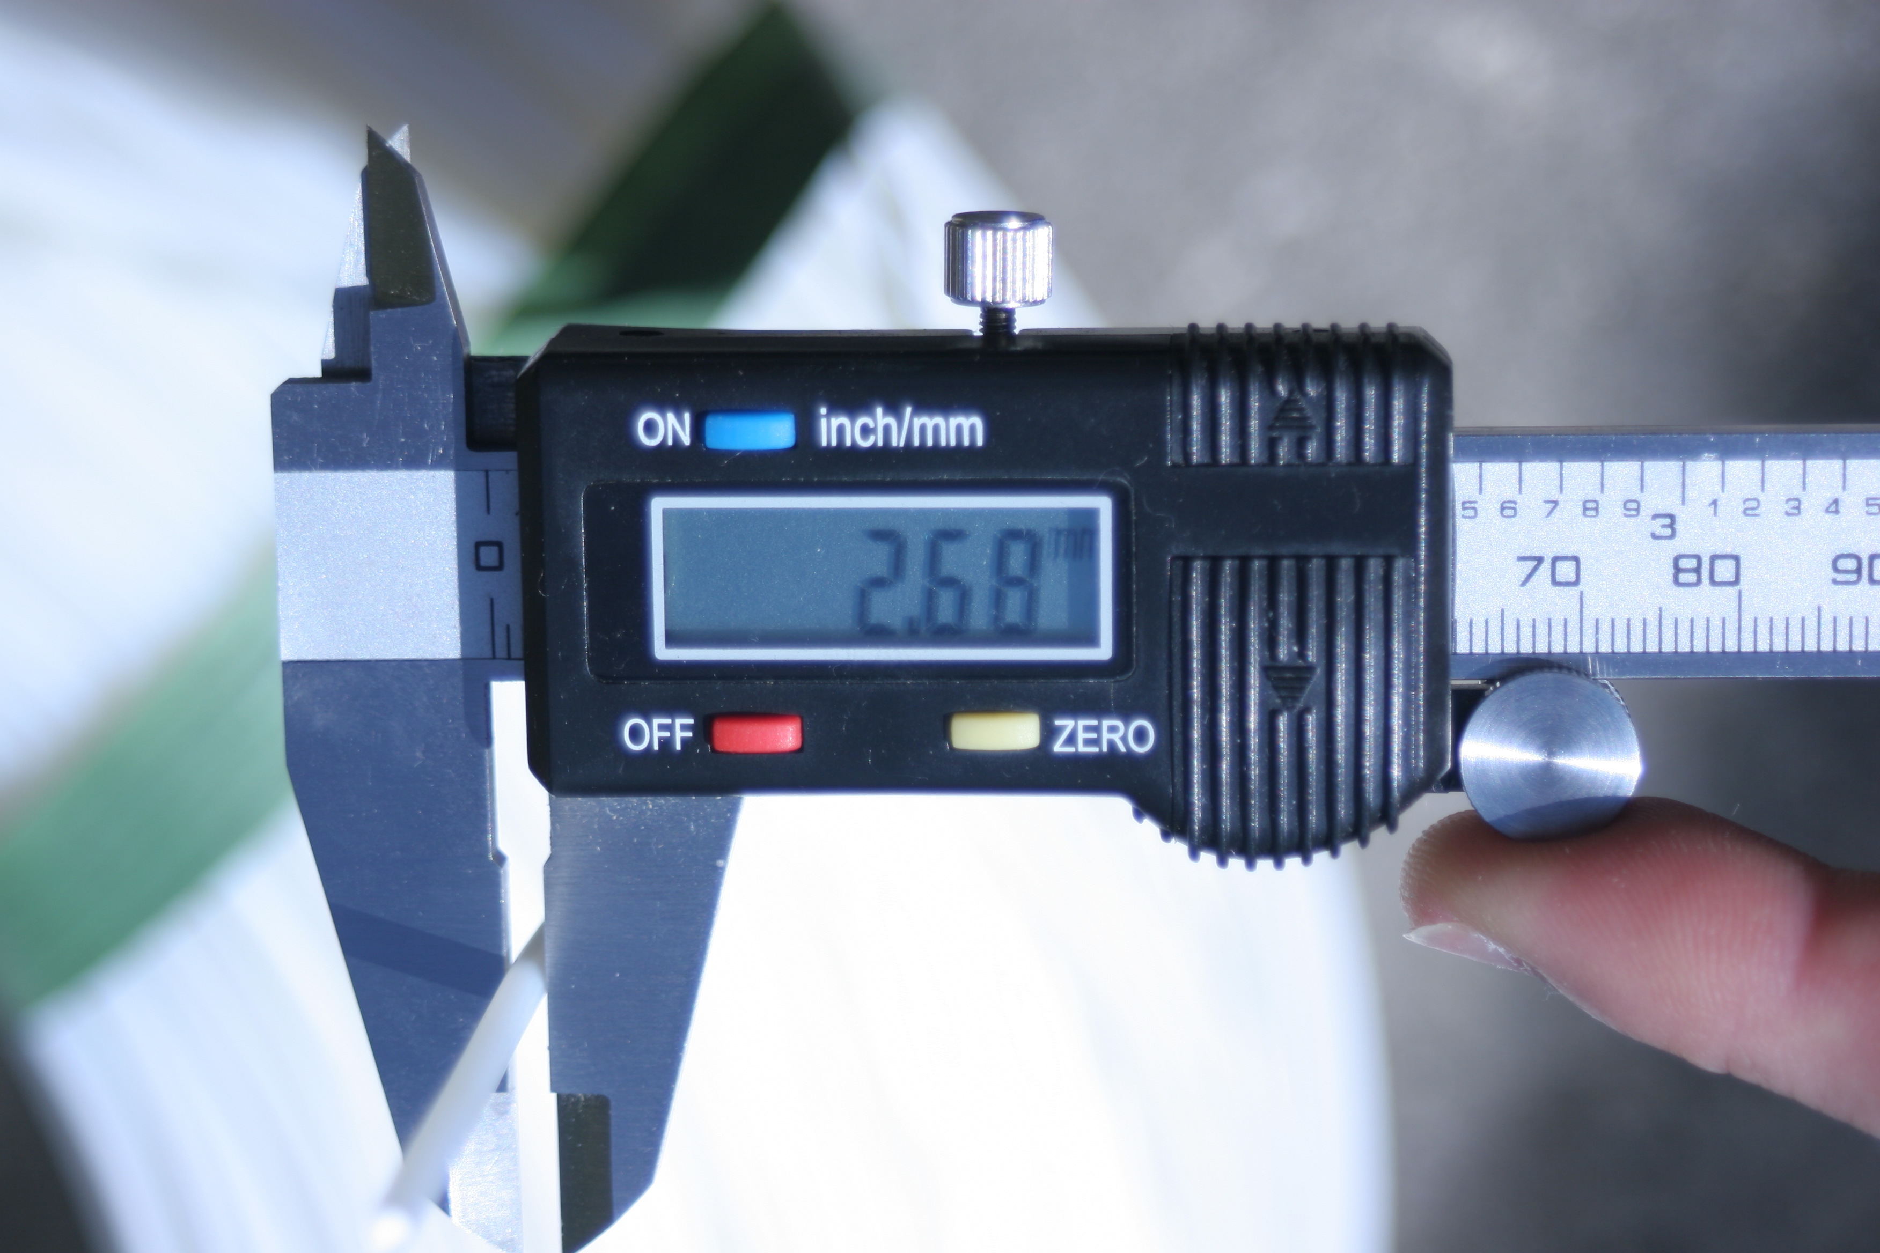
Practical Methods for Better Flow Control: Choice of Filament
Characterizing the flow
Theoretical Causes
Practical Improvements
Two sizes of filament:
3mm diameter
1.8mm diameter
Less thermal inertia (less melt-zone effects)
Less volumetric flow error
Less torque required of filament drive
Source: http://fabricationsofthemind.com/2010/07/05/abs-filament-feedstock-samples-available/

Slide 16
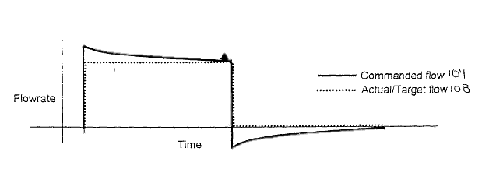
Practical Methods for Better Flow Control: Control Compensation
Characterizing the flow
Theoretical Causes
Practical Improvements
Modify flow rate input to compensate for flow characteristics
Compensation for under-deposition
Compensation for over-deposition
Source: Stratasys

Slide 17
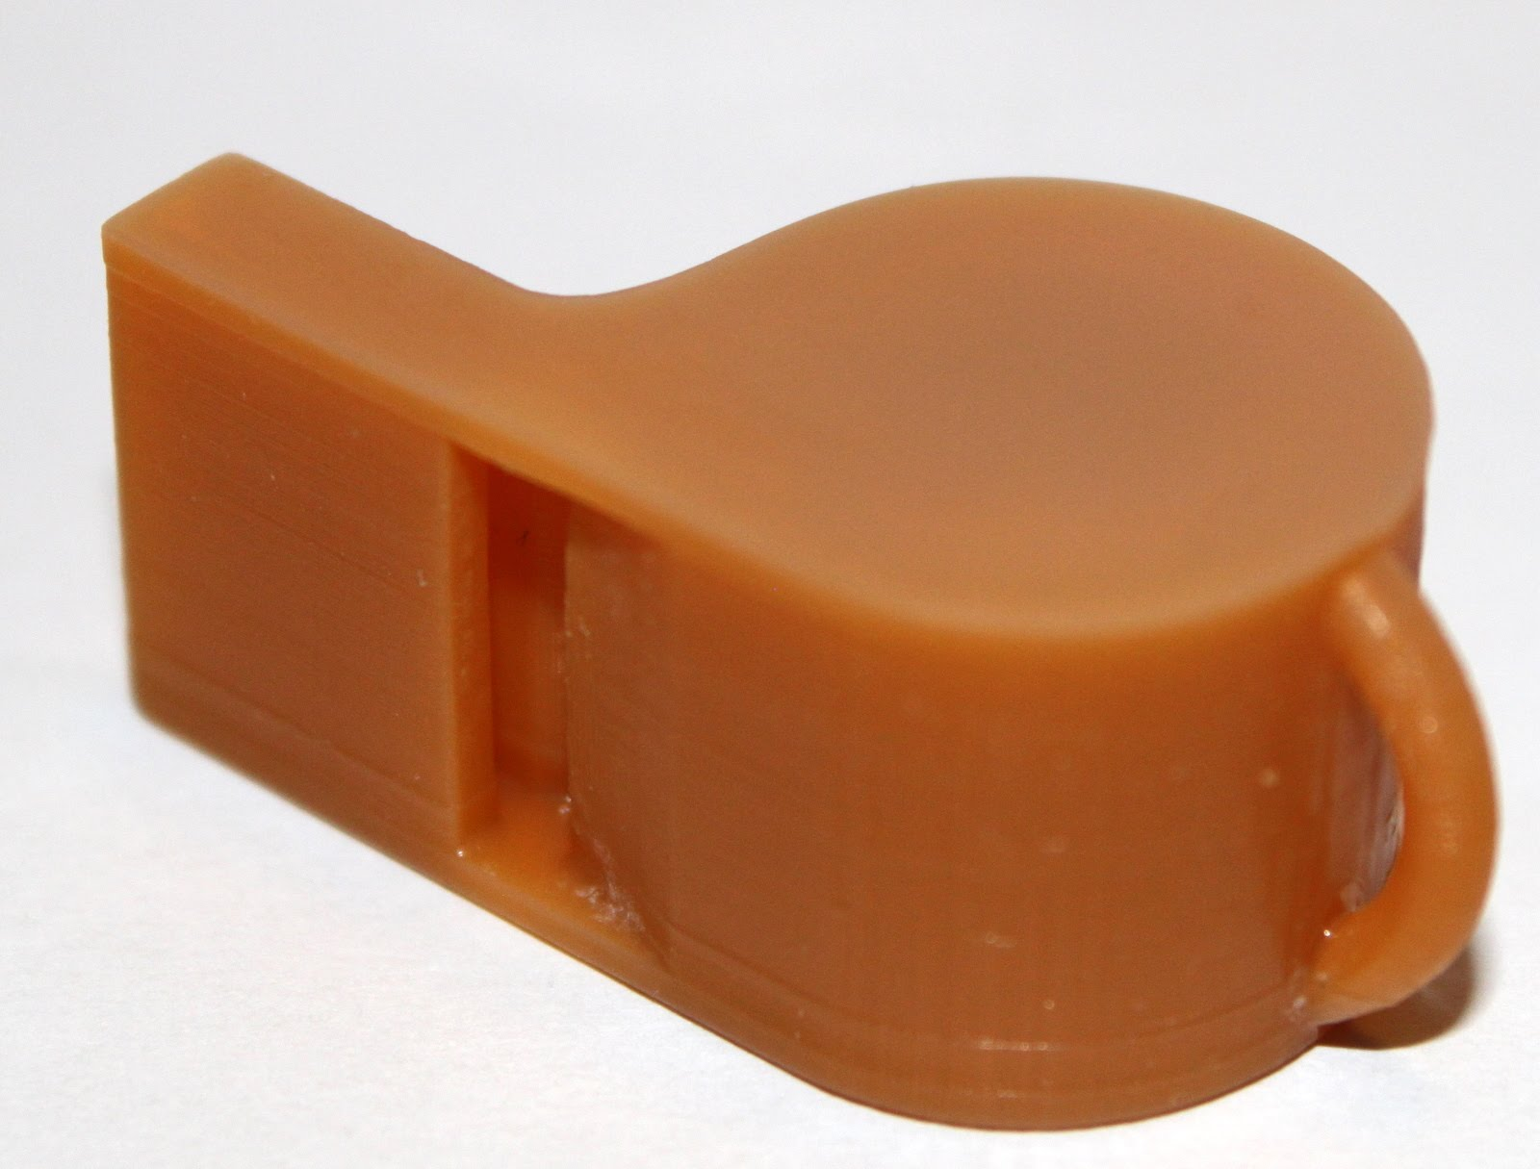
Conclusion
Poor knowledge of extrduer flow → imperfect 3D printed objects
Source: http://blog.cnccookbook.com/2012/02/11/high-resolution-3d-printer
Notes:
Many imperfections in the printing process are caused by poor knowledge of an extruder’s flow

Slide 18
References
William Gurstelle. (2009, June) Boingboing. [Online]. http://boingboing.net/2009/06/13/can-bre-pettis-repli.html
J. Comb, W. Priederman, P. Leavitt, R. Skubic, and J. Batchelder, "High-Precision Modeling Filament," U.S. Patent 124 241, March 15, 2005.
Wikipedia. Fused Deposition Modeling. [Online]. http://en.wikipedia.org/wiki/Fused_deposition_modeling
RepRap. (2012, March) RepRap.org. [Online]. http://reprap.org/wiki/Category:Extruders
W. Swanson and J. Batchelder, "Filament Drive Mechanism for Use in Extrusion-Based Digital Manufacturing," U.S. Patent 7 896 209, March 1, 2011.
J. Batchelder R. Zinniel, "Volumetric Feed Control For Flexible Filament," U.S. Patent 6 085 957, July 11, 2000.
G. Selcuk, and B. Maurizio A. Bellini, "Liquifier Dynamics in Fused Deposition," Journal of Manufacturing Science and Engineering, vol. 126, no. 2, pp. 237-246, 2004.
Makerbot Industries. Makerbot Store - Plastic. [Online]. http://store.makerbot.com/plastic.html
M. Roxas and S. Ju, "Fluid Dynamics Analysis of Dektop-based Fused Deposition Modeling Rapid Prototyping," Department of Mechanical and Industrial Engineering, University of Toronto, Toronto, 2008.
P. Leavitt, and E. Rapoport J. Comb, "Velocity Profiling in an Extrusion Apparatus," U.S. Patent 6 054 077, April 25, 2000.
W. Swanson and J. Batchelder, "Liquefier Assembly for Use in Extrusion-Based Digital Manufacturing Systems," U.S. Patent 7 897 074, March 1, 2011.

Slide 19
Questions?

Slide 20
Theoretical Causes of Imprecise Flow: Filament Effects
Characterizing the flow
Theoretical Causes
Practical Improvements
Volumetric flow error = difference between desired flow rate and output flow rate
Effect of variable filament diameter:
[1]
mean filament diameter
standard deviation
of filament diameter
volumetric flow error
decrease filament diameter
decrease filament diameter variability
(“tighten” tolerance)
To reduce flow errors
[1] Source: Stratasys

Slide 21
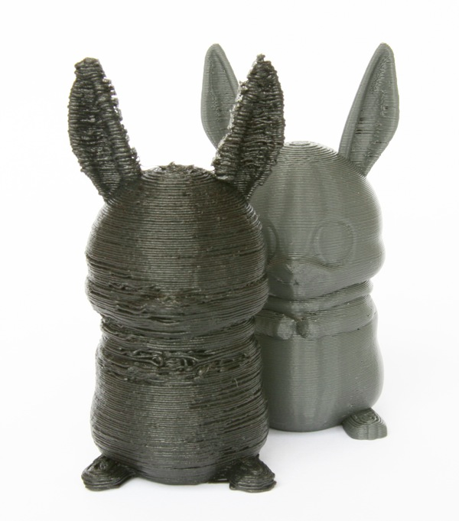
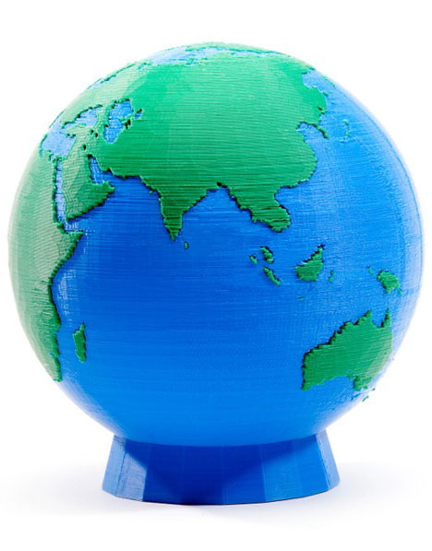
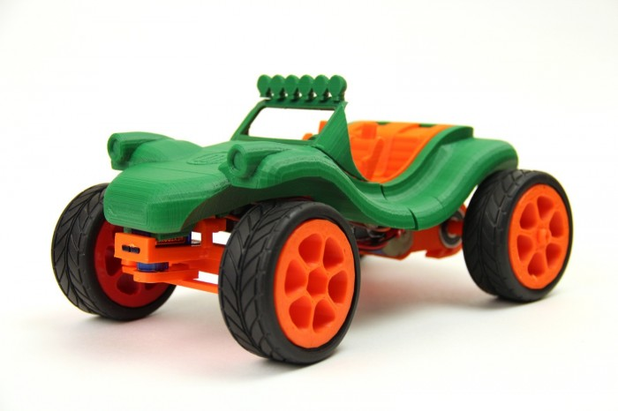
The need for more precise flow control
To Improve quality of 3D printed objects
Shift from prototyping → manufacturing
Enable Dual-Extrusion (using two extruders at the same time) to create objects with multiple materials.
[1]
[2]
[3]
[1] Source: http://www.makerbot.com/blog/tag/makerbot-projects-2/
[2] Source: http://www.core77.com/blog/digital_fabrication/3d_printing_makerbot_industries_new_dual-extrusion_replicator_21513.asp
[3] Source: http://www.shapeways.com/blog/archives/521-The-Shapeways-Makerbot-Bunny.html

Slide 22
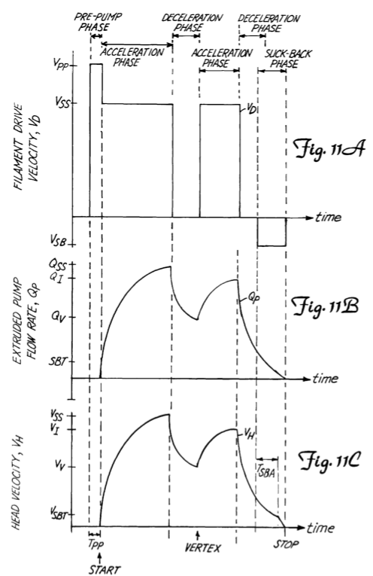
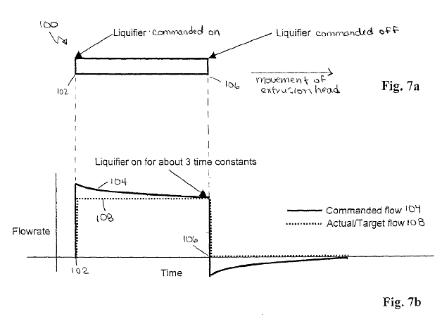
Practical Methods for Better Flow Control: Control Compensation
Characterizing the flow
Theoretical Causes
Practical Improvements
Three methods:
Modify movement speed to match flow rate
Modify flow rate input to compensate for flow characteristics
“close-the-loop” with real-time filament diameter measurements
Source: Stratasys
Source: Stratasys

